Slide 1
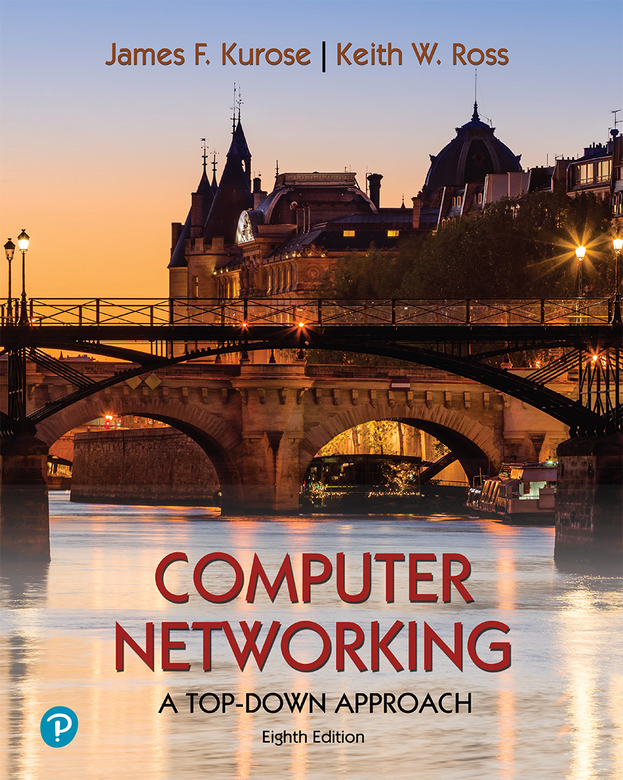
Chapter 5 Network Layer:
Control Plane
Computer Networking: A Top-Down Approach 8th edition Jim Kurose, Keith Ross Pearson, 2020
Acknowledgement: Based on the textbook’s website: https://gaia.cs.umass.edu/kurose_ross/index.php
Notes:
Version History
8.0 (May 2020)
All slides reformatted for 16:9 aspect ratio
All slides updated to 8th edition material
Use of Calibri font, rather that Gill Sans MT
Add LOTS more animation throughout
lighter header font
Re-do of network management slides; redo of Bellman-Ford slides
8.2 (changes over 8.0)
improved animations of Dijkstra’s algorithm and Bellman Ford
various improvements to BGP
SDN: added Google Orion (2021 Google network SDN control plane)

Slide 2
Network layer control plane: our goals
understand principles behind network control plane:
traditional routing algorithms
SDN controllers
network management, configuration
instantiation, implementation in the Internet:
OSPF, BGP
OpenFlow, ODL and ONOS controllers
Internet Control Message Protocol: ICMP
SNMP, YANG/NETCONF

Slide 3

Network layer: “control plane” roadmap
introduction
routing protocols
link state
distance vector
intra-ISP routing: OSPF
routing among ISPs: BGP
SDN control plane
Internet Control Message Protocol
network management, configuration
SNMP
NETCONF/YANG

Slide 4
Network-layer functions
IMPORTANT
forwarding: move packets from router’s input to appropriate router output
data plane
routing: determine route taken by packets from source to destination
control plane
Two approaches to structuring network control plane:
per-router control (traditional)
logically centralized control (software defined networking)

Slide 5

Per-router control plane
IMPORTANT
Individual routing algorithm components in each and every router interact in the control plane
Routing
Algorithm
control
plane
data
plane
values in arriving
packet header
0111
1
3
2

Slide 6
Software-Defined Networking (SDN) control plane
IMPORTANT
Remote controller computes, installs forwarding tables in routers
Remote Controller
control
plane
data
plane
CA
CA
CA
CA
CA
values in arriving
packet header
0111
1
3
2

Slide 7
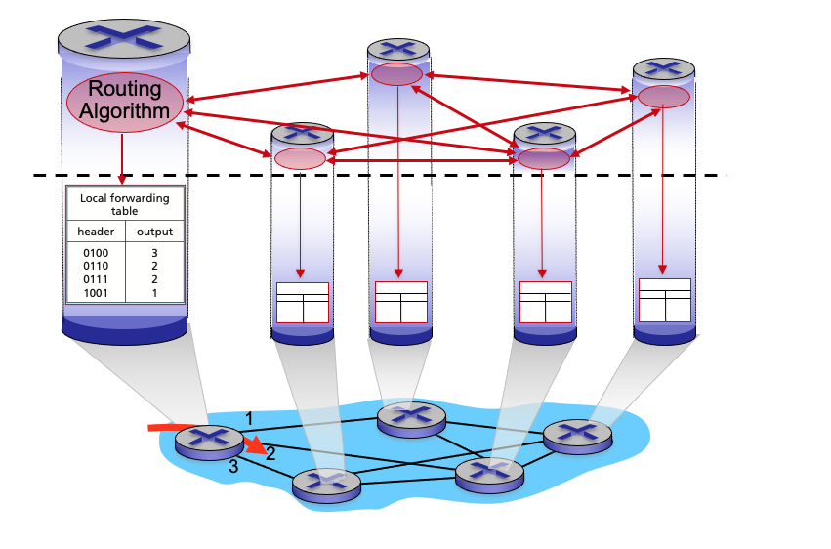
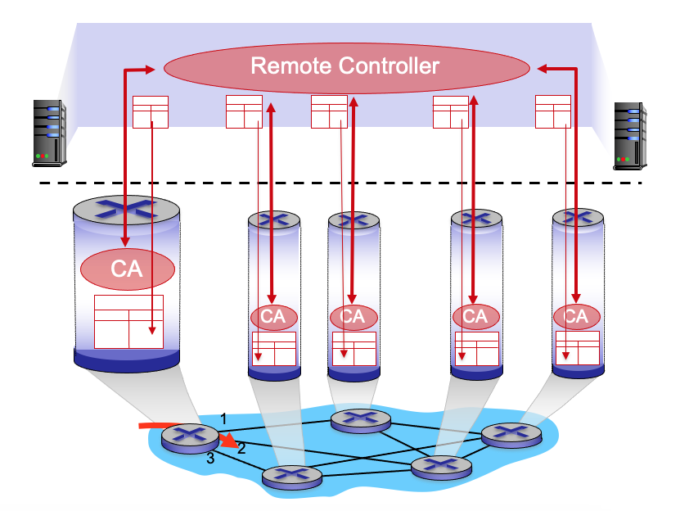
Per-router control plane
IMPORTANT
SDN control plane

Slide 8
Network layer: “control plane” roadmap
introduction
routing protocols
link state
distance vector
intra-ISP routing: OSPF
routing among ISPs: BGP
SDN control plane
Internet Control Message Protocol
network management, configuration
SNMP
NETCONF/YANG

Slide 9
















Routing protocols
IMPORTANT
mobile network
Routing protocol goal: determine “good” paths (equivalently, routes), from sending hosts to receiving host, through network of routers
path: sequence of routers packets traverse from given initial source host to final destination host
“good”: least “cost”, “fastest”, “least congested”
routing: a “top-10” networking challenge!
national or global ISP
application
transport
network
link
physical
network
link
physical
network
link
physical
network
link
physical
network
link
physical
network
link
physical
datacenter
network
application
transport
network
link
physical
enterprise
network

Slide 10
Graph abstraction: link costs
IMPORTANT
5
c_{a,b}: cost of direct link connecting a and b
e.g., c_{w,z} = 5, c_{u,z} = ∞
cost defined by network operator: could always be 1, or inversely related to bandwidth, or inversely related to congestion
v
3
w
2
5
u
2
1
z
3
1
2
x
y
1
graph: G = (N,E)
N: set of routers = { u, v, w, x, y, z }
E: set of links ={ (u,v), (u,x), (v,x), (v,w), (x,w), (x,y), (w,y), (w,z), (y,z) }

Slide 11
Routing algorithm classification
IMPORTANT
global: all routers have complete topology, link cost info
“link state” algorithms
dynamic: routes change more quickly
periodic updates or in response to link cost changes
How fast do routes change?
static: routes change slowly over time
decentralized: iterative process of computation, exchange of info with neighbors
routers initially only know link costs to attached neighbors
“distance vector” algorithms
global or decentralized information?

Slide 12
Network layer: “control plane” roadmap
introduction
routing protocols
link state
distance vector
intra-ISP routing: OSPF
routing among ISPs: BGP
SDN control plane
Internet Control Message Protocol
network management, configuration
SNMP
NETCONF/YANG

Slide 13
Dijkstra’s link-state routing algorithm
IMPORTANT
centralized: network topology, link costs known to all nodes
accomplished via “link state broadcast”
all nodes have same info
computes least cost paths from one node (“source”) to all other nodes
gives forwarding table for that node
iterative: after k iterations, know least cost path to k destinations
notation
c_{x,y}: direct link cost from node x to y; = ∞ if not direct neighbors
D(v): current estimate of cost of least-cost-path from source to destination v
p(v): predecessor node along path from source to v
N': set of nodes whose least-cost-path definitively known

Slide 14
Dijkstra’s link-state routing algorithm
IMPORTANT
1 Initialization:
2 N' = {u} /* compute least cost path from u to all other nodes */
3 for all nodes v
4 if v adjacent to u /* u initially knows direct-path-cost only to direct neighbors */
5 then D(v) = c_{u,v} /* but may not be minimum cost! */
6 else D(v) = ∞
7
8 Loop
9
10
11
12
13
14
15 until all nodes in N'
find w not in N' such that D(w) is a minimum
add w to N'
update D(v) for all v adjacent to w and not in N' :
D(v) = min ( D(v), D(w) + c_{w,v} )
/* new least-path-cost to v is either old least-cost-path to v or known
least-cost-path to w plus direct-cost from w to v */

Slide 15
Dijkstra’s algorithm: an example
IMPORTANT
v
w
x
y
z
Step
0
1
2
3
4
5
N'
D(v),p(v)
D(w),p(w)
D(x),p(x)
D(y),p(y)
D(z),p(z)
u
2,u
5,u
1,u
∞
∞
D(w),p(w)
5,u
4,x
3,y
3,y
5
Initialization (step 0):
For all a: if a adjacent to u then D(a) = c_{u,a}
v
3
w
2
5
u
2
1
z
3
1
2
x
y
1

Slide 16
Dijkstra’s algorithm: an example
IMPORTANT
v
w
x
y
z
Step
0
1
2
3
4
5
N'
D(v),p(v)
D(w),p(w)
D(x),p(x)
D(y),p(y)
D(z),p(z)
u
2,u
5,u
1,u
∞
∞
ux
D(w),p(w)
5,u
4,x
3,y
3,y
8 Loop
9
10
find a not in N' such that D(a) is a minimum
add a to N'
5
v
3
w
2
5
u
2
1
z
3
1
2
x
y
1

Slide 17

Dijkstra’s algorithm: an example
IMPORTANT
v
w
x
y
z
Step
0
1
2
3
4
5
N'
D(v),p(v)
D(w),p(w)
D(x),p(x)
D(y),p(y)
D(z),p(z)
u
2,u
5,u
1,u
∞
∞
ux
2,u
4,x
2,x
∞
D(w),p(w)
5,u
4,x
3,y
3,y
8 Loop
9
10
11
find a not in N' such that D(a) is a minimum
add a to N'
5
v
3
w
2
5
update D(b) for all b adjacent to a and not in N' :
D(b) = min ( D(b), D(a) + c_{a,b} )
u
2
1
z
3
1
2
D(v) = min ( D(v), D(x) + c_{x,v} ) = min(2, 1+2) = 2
x
y
1
D(w) = min ( D(w), D(x) + c_{x,w} ) = min (5, 1+3) = 4
D(y) = min ( D(y), D(x) + c_{x,y} ) = min(inf,1+1) = 2

Slide 18
Dijkstra’s algorithm: an example
IMPORTANT
v
w
x
y
z
Step
0
1
2
3
4
5
N'
D(v),p(v)
D(w),p(w)
D(x),p(x)
D(y),p(y)
D(z),p(z)
u
2,u
5,u
1,u
∞
∞
ux
2,u
4,x
2,x
∞
uxy
D(w),p(w)
5,u
4,x
3,y
3,y
8 Loop
9
10
find a not in N' such that D(a) is a minimum
add a to N'
5
v
3
w
2
5
u
2
1
z
3
1
2
x
y
1

Slide 19
Dijkstra’s algorithm: an example
IMPORTANT
v
w
x
y
z
Step
0
1
2
3
4
5
N'
D(v),p(v)
D(w),p(w)
D(x),p(x)
D(y),p(y)
D(z),p(z)
u
2,u
5,u
1,u
∞
∞
ux
2,u
4,x
2,x
∞
uxy
2,u
3,y
4,y
8 Loop
9
10
11
find a not in N' such that D(a) is a minimum
add a to N'
5
v
3
w
2
5
update D(b) for all b adjacent to a and not in N' :
D(b) = min ( D(b), D(a) + c_{a,b} )
u
2
1
z
3
1
2
D(w) = min ( D(w), D(y) + c_{y,w} ) = min (4, 2+1) = 3
x
y
1
D(z) = min ( D(z), D(y) + c_{y,z} ) = min(inf,2+2) = 4

Slide 20
Dijkstra’s algorithm: an example
IMPORTANT
v
w
x
y
z
Step
0
1
2
3
4
5
N'
D(v),p(v)
D(w),p(w)
D(x),p(x)
D(y),p(y)
D(z),p(z)
u
2,u
5,u
1,u
∞
∞
ux
2,u
4,x
2,x
∞
uxy
2,u
3,y
4,y
uxyv
8 Loop
9
10
find a not in N' such that D(a) is a minimum
add a to N'
5
v
3
w
2
5
u
2
1
z
3
1
2
x
y
1

Slide 21
Dijkstra’s algorithm: an example
IMPORTANT
v
w
x
y
z
Step
0
1
2
3
4
5
N'
D(v),p(v)
D(w),p(w)
D(x),p(x)
D(y),p(y)
D(z),p(z)
u
2,u
5,u
1,u
∞
∞
ux
2,u
4,x
2,x
∞
uxy
2,u
3,y
4,y
uxyv
3,y
4,y
8 Loop
9
10
11
find a not in N' such that D(a) is a minimum
add a to N'
5
v
3
w
2
5
update D(b) for all b adjacent to a and not in N' :
D(b) = min ( D(b), D(a) + c_{a,b} )
u
2
1
z
3
1
2
D(w) = min ( D(w), D(v) + c_{v,w} ) = min (3, 2+3) = 3
x
y
1

Slide 22
Dijkstra’s algorithm: an example
IMPORTANT
v
w
x
y
z
Step
0
1
2
3
4
5
N'
D(v),p(v)
D(w),p(w)
D(x),p(x)
D(y),p(y)
D(z),p(z)
u
2,u
5,u
1,u
∞
∞
ux
2,u
4,x
2,x
∞
uxy
2,u
3,y
4,y
uxyv
3,y
4,y
uxyvw
8 Loop
9
10
find a not in N' such that D(a) is a minimum
add a to N'
5
v
3
w
2
5
u
2
1
z
3
1
2
x
y
1

Slide 23
Dijkstra’s algorithm: an example
IMPORTANT
v
w
x
y
z
Step
0
1
2
3
4
5
N'
D(v),p(v)
D(w),p(w)
D(x),p(x)
D(y),p(y)
D(z),p(z)
u
2,u
5,u
1,u
∞
∞
ux
2,u
4,x
2,x
∞
uxy
2,u
3,y
4,y
uxyv
3,y
4,y
uxyvw
4,y
8 Loop
9
10
11
find a not in N' such that D(a) is a minimum
add a to N'
5
v
3
w
2
5
update D(b) for all b adjacent to a and not in N' :
D(b) = min ( D(b), D(a) + c_{a,b} )
u
2
1
z
3
1
2
D(z) = min ( D(z), D(w) + c_{w,z} ) = min (4, 3+5) = 4
x
y
1

Slide 24
Dijkstra’s algorithm: an example
IMPORTANT
v
w
x
y
z
Step
0
1
2
3
4
5
N'
D(v),p(v)
D(w),p(w)
D(x),p(x)
D(y),p(y)
D(z),p(z)
u
2,u
5,u
1,u
∞
∞
ux
2,u
4,x
2,x
∞
uxy
2,u
3,y
4,y
uxyv
3,y
4,y
uxyvw
4,y
uxyvwz
8 Loop
9
10
find a not in N' such that D(a) is a minimum
add a to N'
5
v
3
w
2
5
u
2
1
z
3
1
2
x
y
1

Slide 25
Dijkstra’s algorithm: an example
IMPORTANT
v
w
x
y
z
Step
0
1
2
3
4
5
N'
D(v),p(v)
D(w),p(w)
D(x),p(x)
D(y),p(y)
D(z),p(z)
u
2,u
5,u
1,u
∞
∞
ux
2,u
4,x
2,x
∞
uxy
2,u
3,y
4,y
uxyv
3,y
4,y
uxyvw
4,y
uxyvwz
8 Loop
9
10
11
find a not in N' such that D(a) is a minimum
add a to N'
5
v
3
w
2
5
update D(b) for all b adjacent to a and not in N' :
D(b) = min ( D(b), D(a) + c_{a,b} )
u
2
1
z
3
1
2
x
y
1

Slide 26
Dijkstra’s algorithm: an example
IMPORTANT
v
w
x
y
z
Step
0
1
2
3
4
5
N'
D(v),p(v)
D(w),p(w)
D(x),p(x)
D(y),p(y)
D(z),p(z)
u
2,u
5,u
1,u
∞
∞
ux
2,u
4,x
2,x
∞
uxy
2,u
3,y
4,y
uxyv
3,y
4,y
D(w),p(w)
5,u
4,x
3,y
3,y
uxyvw
4,y
uxyvwz
Initialization (step 0): For all a: if a adjacent to then D(a) = c_{u,a}
5
find a not in N' such that D(a) is a minimum
add a to N'
update D(b) for all b adjacent to a and not in N' :
D(b) = min ( D(b), D(a) + c_{a,b} )
v
3
w
2
5
u
2
1
z
3
1
2
x
y
1

Slide 27
Dijkstra’s algorithm: an example
IMPORTANT
5
v
3
w
2
5
u
2
1
z
3
1
2
D(w),p(w)
5,u
4,x
3,y
3,y
x
y
1
resulting least-cost-path tree from u:
resulting forwarding table in u:
v
w
destination
outgoing link
v
x
y
w
x
(u,v)
(u,x)
(u,x)
(u,x)
(u,x)
route from u to v directly
u
z
x
route from u to all other destinations via x
y

Slide 28
Dijkstra’s algorithm: another example
IMPORTANT
v
w
x
y
z
x
D(v),
p(v)
D(w),
p(w)
D(x),
p(x)
D(y),
p(y)
D(z),
p(z)
9
Step
N'
0
u
7,u
3,u
5,u
∞
∞
5
7
4
1
uw
6,w
5,u
11,w
∞
8
2
uwx
6,w
11,w
14,x
u
3
w
y
z
2
3
uwxv
10,v
14,x
3
4
uwxvy
12,y
7
4
5
uwxvyz
v
notes:
construct least-cost-path tree by tracing predecessor nodes
ties can exist (can be broken arbitrarily)

Slide 29
Dijkstra’s algorithm: discussion
IMPORTANT
algorithm complexity: n nodes
each of n iteration: need to check all nodes, w, not in N
n(n+1)/2 comparisons: O(n²) complexity
more efficient implementations possible: O(nlogn)
message complexity:
each router must broadcast its link state information to other n routers
efficient (and interesting!) broadcast algorithms: O(n) link crossings to disseminate a broadcast message from one source
each router’s message crosses O(n) links: overall message complexity: O(n²)

Slide 30
Dijkstra’s algorithm: oscillations possible
when link costs depend on traffic volume, route oscillations possible
sample scenario:
routing to destination a, traffic entering at d, c, e with rates 1, e (<1), 1
link costs are directional, and volume-dependent
a
a
a
a
1
1+e
2+e
0
0
2+e
2+e
0
d
b
d
1
b
d
b
d
b
0
0
1+e
0
0
1+e
1
1
0
e
1
0
c
0
1
1
1
c
1+e
1
1
0
0
1
c
1
c
e
e
e
e
given these costs,
find new routing….
resulting in new costs
given these costs,
find new routing….
resulting in new costs
given these costs,
find new routing….
resulting in new costs
initially

Slide 31
Network layer: “control plane” roadmap
introduction
routing protocols
link state
distance vector
intra-ISP routing: OSPF
routing among ISPs: BGP
SDN control plane
Internet Control Message Protocol
network management, configuration
SNMP
NETCONF/YANG

Slide 32
Distance vector algorithm
IMPORTANT
Based on Bellman-Ford (BF) equation (dynamic programming):
Bellman-Ford equation
Let D_{x}(y): cost of least-cost path from x to y.
Then:
D_{x}(y) = min_{v} { c_{x,v} + D_{v}(y) }
v’s estimated least-cost-path cost to y
min taken over all neighbors v of x
direct cost of link from x to v
Notes:
distTo[w] = min(distTo[w], distTo[v] + e.weight());

Slide 33
Bellman-Ford (BF) equation
IMPORTANT
Recall edge relaxation for the one edge connecting v and y:
D_{x}(y) = min { D_{x}(y), c_{x,v} + D_{v}(y) }
Perform edge relaxation for all vertices v connected to x, we have the B-F equation
D_{x}(y) = min_{v} { c_{x,v} + D_{v}(y) }
In L. 5.0 we centralized global synchronous version of BF algorithm, where all edges are relaxed in each iteration. Here we consider decentralized asynchronous version of BF algorithm.
Notes:
D_{u}(z) = min { c_{u,v} + D_{v}(z),
c_{u,x} + D_{x}(z),
c_{u,w} + D_{w}(z) }

Slide 34
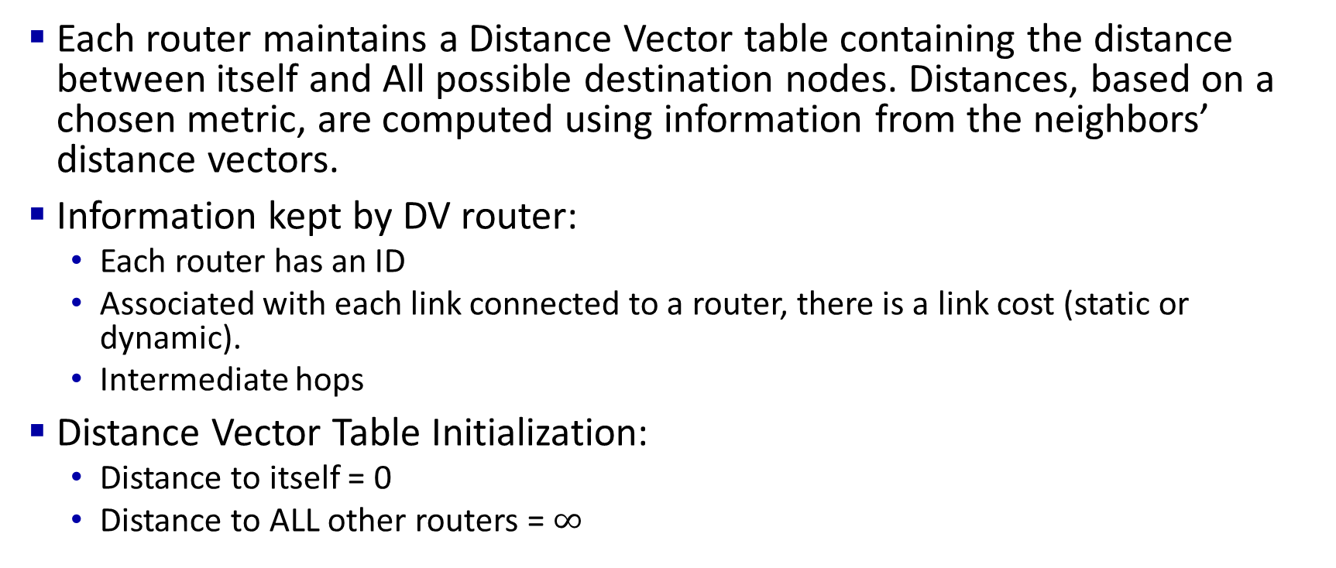
Bellman-Ford Algorithm
IMPORTANT
Each router maintains a Distance Vector table containing the distance between itself and All possible destination nodes. Distances, based on a chosen metric, are computed using information from the neighbors’ distance vectors.
Information kept by DV router:
Each router has an ID
Associated with each link connected to a router, there is a link cost (static or dynamic).
Intermediate hops
Distance Vector Table Initialization:
Distance to itself = 0
Distance to ALL other routers = $∞$

Slide 35
Bellman-Ford Example
IMPORTANT
Suppose that u’s neighboring nodes, x,v,w, know that for destination z:
D_{v}(z) = 5
D_{w}(z) = 3
Bellman-Ford equation says:
5
D_{u}(z) = min { c_{u,v} + D_{v}(z),
c_{u,x} + D_{x}(z),
c_{u,w} + D_{w}(z) }
v
3
w
2
5
u
2
1
z
3
= min {2 + 5,
1 + 3,
5 + 3} = 4
1
2
x
y
1
D_{x}(z) = 3
node achieving minimum (x) is next hop on estimated least-cost path to destination (z)

Slide 36
Distance vector algorithm
IMPORTANT
key idea:
Decentralized gossip algorithm based on local information: “I tell my neighbors, you tell yours.”
from time-to-time, each node sends its own distance vector estimate to neighbors
when x receives new DV estimate from any neighbor v, it updates its own DV using B-F equation:
D_{x}(y) ← min_{v}{c_{x,v} + D_{v}(y)} for each node y ∊ N
under minor conditions, the estimate D_{x}(y) converge to the actual least cost d_{x}(y)

Slide 37
Distance vector algorithm:
IMPORTANT
each node:
iterative, asynchronous: each local iteration caused by:
local link cost change
DV update message from neighbor
wait for (change in local link cost or msg from neighbor)
recompute DV estimates using DV received from neighbor
distributed, self-stopping: each node notifies neighbors only when its DV changes
neighbors then notify their neighbors – only if necessary
no notification received, no actions taken!
if DV to any destination has changed, notify neighbors

Slide 38
Distance vector: example
DV in a: D_{a}(a)=0
D_{a}(b) = 8
D_{a}(c) = ∞
D_{a}(d) = 1
D_{a}(e) = ∞
D_{a}(f) = ∞
D_{a}(g) = ∞
D_{a}(h) = ∞
D_{a}(i) = ∞
a
b
c
8
1
t=0
1
1
All nodes have distance estimates to nearest neighbors (only)
A few asymmetries:
missing link
larger cost
d
e
f
1
1
All nodes send their local distance vector to their neighbors
1
1
1
g
h
i
1
1

Slide 39
Distance vector example: iteration
a
b
c
8
1
t=1
1
1
All nodes:
receive distance vectors from neighbors
compute their new local distance vector
send their new local distance vector to neighbors
d
e
f
1
1
1
1
1
g
h
i
1
1

Slide 40
Distance vector example: iteration
a
compute
compute
compute
b
c
8
1
t=1
1
1
All nodes:
receive distance vectors from neighbors
compute their new local distance vector
send their new local distance vector to neighbors
d
compute
e
f
compute
compute
1
1
1
1
1
g
h
i
compute
compute
1
compute
1

Slide 41
Distance vector example: iteration
a
b
c
8
1
t=1
1
1
All nodes:
receive distance vectors from neighbors
compute their new local distance vector
send their new local distance vector to neighbors
d
e
f
1
1
1
1
1
g
h
i
1
1

Slide 42
Distance vector example: iteration
a
b
c
8
1
t=2
1
1
All nodes:
receive distance vectors from neighbors
compute their new local distance vector
send their new local distance vector to neighbors
d
e
f
1
1
1
1
1
g
h
i
1
1

Slide 43
Distance vector example: iteration
compute
compute
compute
a
b
c
2
1
t=2
1
1
All nodes:
receive distance vectors from neighbors
compute their new local distance vector
send their new local distance vector to neighbors
d
compute
compute
compute
e
f
1
1
1
1
1
g
compute
compute
compute
h
i
8
1

Slide 44
Distance vector example: iteration
a
b
c
8
1
t=2
1
1
All nodes:
receive distance vectors from neighbors
compute their new local distance vector
send their new local distance vector to neighbors
d
e
f
1
1
1
1
1
g
h
i
1
1

Slide 45
Distance vector example: iteration
…. and so on
Let’s next take a look at the iterative computations at nodes

Slide 46
Distance vector example: computation
DV in b:
DV in c:
D_{c}(a) = ∞
D_{c}(b) = 1
D_{c}(c) = 0
D_{c}(d) = ∞
D_{c}(e) = ∞
D_{c}(f) = ∞
D_{c}(g) = ∞
D_{c}(h) = ∞
D_{c}(i) = ∞
D_{b}(a) = 8
D_{b}(c) = 1
D_{b}(d) = ∞
D_{b}(e) = 1
D_{b}(f) = ∞
D_{b}(g) = ∞
D_{b}(h) = ∞
D_{b}(i) = ∞
DV in a: D_{a}(a)=0
D_{a}(b) = 8
D_{a}(c) = ∞
D_{a}(d) = 1
D_{a}(e) = ∞
D_{a}(f) = ∞
D_{a}(g) = ∞
D_{a}(h) = ∞
D_{a}(i) = ∞
a
b
c
8
1
t=1
1
1
b receives DVs from a, c, e
DV in e:
D_{e}(a) = ∞
D_{e}(b) = 1
D_{e}(c) = ∞
D_{e}(d) = 1
D_{e}(e) = 0
D_{e}(f) = 1
D_{e}(g) = ∞
D_{e}(h) = 1
D_{e}(i) = ∞
d
e
f
1
1
1
1
1
g
h
i
1
1

Slide 47
Distance vector example: computation
DV in b:
DV in c:
D_{c}(a) = ∞
D_{c}(b) = 1
D_{c}(c) = 0
D_{c}(d) = ∞
D_{c}(e) = ∞
D_{c}(f) = ∞
D_{c}(g) = ∞
D_{c}(h) = ∞
D_{c}(i) = ∞
D_{b}(a) = 8
D_{b}(c) = 1
D_{b}(d) = ∞
D_{b}(e) = 1
D_{b}(f) = ∞
D_{b}(g) = ∞
D_{b}(h) = ∞
D_{b}(i) = ∞
DV in a: D_{a}(a)=0
D_{a}(b) = 8
D_{a}(c) = ∞
D_{a}(d) = 1
D_{a}(e) = ∞
D_{a}(f) = ∞
D_{a}(g) = ∞
D_{a}(h) = ∞
D_{a}(i) = ∞
a
b
c
b
8
compute
1
t=1
1
1
b receives DVs from a, c, e, computes:
DV in e:
D_{e}(a) = ∞
D_{e}(b) = 1
D_{e}(c) = ∞
D_{e}(d) = 1
D_{e}(e) = 0
D_{e}(f) = 1
D_{e}(g) = ∞
D_{e}(h) = 1
D_{e}(i) = ∞
e
d
e
f
1
1
D_{b}(a) = min{c_{b,a}+D_{a}(a), c_{b,c} +D_{c}(a), c_{b,e}+D_{e}(a)} = min{8,∞,∞} = 8
D_{b}(c) = min{c_{b,a}+D_{a}(c), c_{b,c} +D_{c}(c), c _{b,e} +D_{e}(c)} = min{∞,1,∞} = 1
D_{b}(d) = min{c_{b,a}+D_{a}(d), c_{b,c} +D_{c}(d), c _{b,e} +D_{e}(d)} = min{9,∞,2} = 2
1
1
D_{b}(e) = min{c_{b,a}+D_{a}(e), c_{b,c} +D_{c}(e), c _{b,e} +D_{e}(e)} = min{∞,∞,1} = 1
DV in b:
D_{b}(f) = min{c_{b,a}+D_{a}(f), c_{b,c} +D_{c}(f), c _{b,e} +D_{e}(f)} = min{∞,∞,2} = 2
D_{b}(g) = min{c_{b,a}+D_{a}(g), c_{b,c} +D_{c}(g), c _{b,e}+D_{e}(g)} = min{∞, ∞, ∞} = ∞
D_{b}(a) = 8
D_{b}(c) = 1
D_{b}(d) = 2
D_{b}(e) = 1
D_{b}(f) =2
D_{b}(g) = ∞
D_{b}(h) = 2
D_{b}(i) = ∞
g
h
1
i
1
D_{b}(h) = min{c_{b,a}+D_{a}(h), c_{b,c} +D_{c}(h), c _{b,e}+D_{e}(h)} = min{∞, ∞, 2} = 2
D_{b}(i) = min{c_{b,a}+D_{a}(i), c_{b,c} +D_{c}(i), c _{b,e}+D_{e}(i)} = min{∞, ∞, ∞} = ∞

Slide 48
Distance vector example: computation
DV in b:
DV in c:
D_{c}(a) = ∞
D_{c}(b) = 1
D_{c}(c) = 0
D_{c}(d) = ∞
D_{c}(e) = ∞
D_{c}(f) = ∞
D_{c}(g) = ∞
D_{c}(h) = ∞
D_{c}(i) = ∞
D_{b}(a) = 8
D_{b}(c) = 1
D_{b}(d) = ∞
D_{b}(e) = 1
D_{b}(f) = ∞
D_{b}(g) = ∞
D_{b}(h) = ∞
D_{b}(i) = ∞
DV in a: D_{a}(a)=0
D_{a}(b) = 8
D_{a}(c) = ∞
D_{a}(d) = 1
D_{a}(e) = ∞
D_{a}(f) = ∞
D_{a}(g) = ∞
D_{a}(h) = ∞
D_{a}(i) = ∞
a
b
c
8
1
t=1
1
1
c receives DVs from b
DV in e:
D_{e}(a) = ∞
D_{e}(b) = 1
D_{e}(c) = ∞
D_{e}(d) = 1
D_{e}(e) = 0
D_{e}(f) = 1
D_{e}(g) = ∞
D_{e}(h) = 1
D_{e}(i) = ∞
d
e
f
1
1
1
1
1
g
h
i
1
1

Slide 49
Distance vector example: computation
DV in b:
DV in c:
D_{c}(a) = ∞
D_{c}(b) = 1
D_{c}(c) = 0
D_{c}(d) = ∞
D_{c}(e) = ∞
D_{c}(f) = ∞
D_{c}(g) = ∞
D_{c}(h) = ∞
D_{c}(i) = ∞
D_{b}(a) = 8
D_{b}(c) = 1
D_{b}(d) = ∞
D_{b}(e) = 1
D_{b}(f) = ∞
D_{b}(g) = ∞
D_{b}(h) = ∞
D_{b}(i) = ∞
a
b
c
1
compute
8
t=1
1
1
c receives DVs from b computes:
d
e
f
D_{c}(a) = min{c_{c,b}+D_{b}(a}} = 1 + 8 = 9
DV in c:
D_{c}(a) = 9
D_{c}(b) = 1
D_{c}(c) = 0
D_{c}(d) = 2
D_{c}(e) = ∞
D_{c}(f) = ∞
D_{c}(g) = ∞
D_{c}(h) = ∞
D_{c}(i) = ∞
D_{c}(b) = min{c_{c,b}+D_{b}(b)} = 1 + 0 = 1
D_{c}(d) = min{c_{c,b}+D_{b}(d)} = 1+ ∞ = ∞
D_{c}(e) = min{c_{c,b}+D_{b}(e)} = 1 + 1 = 2
D_{c}(f) = min{c_{c,b}+D_{b}(f)} = 1+ ∞ = ∞
D_{c}(g) = min{c_{c,b}+D_{b}(g)} = 1+ ∞ = ∞
* Check out the online interactive exercises for more examples: http://gaia.cs.umass.edu/kurose_ross/interactive/
g
h
i
D_{c}(h) = min{c_{bc,b}+D_{b}(h)} = 1+ ∞ = ∞
D_{c}(i) = min{c_{c,b}+D_{b}(i)} = 1+ ∞ = ∞

Slide 50
Distance vector example: computation
DV in b:
D_{b}(a) = 8
D_{b}(c) = 1
D_{b}(d) = ∞
D_{b}(e) = 1
D_{b}(f) = ∞
D_{b}(g) = ∞
D_{b}(h) = ∞
D_{b}(i) = ∞
DV in e:
D_{e}(a) = ∞
D_{e}(b) = 1
D_{e}(c) = ∞
D_{e}(d) = 1
D_{e}(e) = 0
D_{e}(f) = 1
D_{e}(g) = ∞
D_{e}(h) = 1
D_{e}(i) = ∞
DV in d:
D_{c}(a) = 1
D_{c}(b) = ∞
D_{c}(c) = ∞
D_{c}(d) = 0
D_{c}(e) = 1
D_{c}(f) = ∞ D_{c}(g) = 1
D_{c}(h) = ∞
D_{c}(i) = ∞
a
b
c
8
1
t=1
Q: what is new DV computed in e at t=1?
1
1
e receives DVs from b, d, f, h
d
compute
f
DV in f:
D_{c}(a) = ∞
D_{c}(b) = ∞
D_{c}(c) = ∞
D_{c}(d) = ∞
D_{c}(e) = 1
D_{c}(f) = 0
D_{c}(g) = ∞
D_{c}(h) = ∞
D_{c}(i) = 1
e
DV in h:
D_{c}(a) = ∞
D_{c}(b) = ∞
D_{c}(c) = ∞
D_{c}(d) = ∞
D_{c}(e) = 1
D_{c}(f) = ∞
D_{c}(g) = 1
D_{c}(h) = 0
D_{c}(i) = 1
1
1
1
1
1
g
h
i
1
1

Slide 51
Distance vector: state information diffusion
Iterative communication, computation steps diffuses information through network:
t=0
c’s state at t=0 is at c only
a
b
c
8
1
c’s state at t=0 has propagated to b, and may influence distance vector computations up to 1 hop away, i.e., at b
t=1
1
1
t=1
t=2
c’s state at t=0 may now influence distance vector computations up to 2 hops away, i.e., at b and now at a, e as well
t=2
d
e
f
1
1
t=3
c’s state at t=0 may influence distance vector computations up to 3 hops away, i.e., at d, f, h
1
1
1
t=3
c’s state at t=0 may influence distance vector computations up to 4 hops away, i.e., at g, i
t=4
g
h
i
1
1
t=4

Slide 52
Distance vector: another example
D_{x}()
cost to
cost to
x y z
x y z
x
0 2 7
x
0
2
3
y
y
2 0 1
from
∞
∞
∞
from
D_{x}(z) = min{c_{x,y}+ D_{y}(z), c_{x,z}+ D_{z}(z)}
= min{2+1 , 7+0} = 3
z
∞
∞
∞
z
7 1 0
cost to
y
D_{y}()
x y z
2
1
D_{x}(y) = min{c_{x,y} + D_{y}(y), c_{x,z}+ D_{z}(y)} = min{2+0 , 7+1} = 2
z
x
∞
∞
x
∞
2 0 1
7
from
y
z
∞
∞
∞
D_{z}()
cost to
x y z
x
∞ ∞ ∞
from
y
∞
∞
∞
z
7
1
0
time

Slide 53
Distance vector: another example
y’s DV did not change after 1st iteration,
so do not propagate its DV to neighbors
D_{x}()
cost to
cost to
cost to
x y z
x y z
x y z
x
0 2 7
x
0
2
3
x
0 2 3
y
y
2 0 1
from
∞
∞
∞
from
y
2 0 1
z
z
from
∞
∞
∞
7 1 0
z
3 1 0
cost to
cost to
cost to
y
D_{y}()
x y z
x y z
x y z
2
1
x
∞
∞
x
0 2 7
x
z
∞
2 0 1
x
0 2 3
7
from
y
y
2 0 1
y
from
from
2 0 1
z
∞
∞
∞
z
7 1 0
z
3 1 0
cost to
cost to
cost to
D_{z}()
x y z
x y z
x y z
x
∞ ∞ ∞
x
0 2 7
x
0 2 3
y
y
2 0 1
from
y
∞
∞
from
2 0 1
from
∞
z
z
3 1 0
z
3 1 0
7
1
0
time

Slide 54
Distance vector: link cost changes
IMPORTANT
link cost changes:
node detects local link cost change
updates routing info, recalculates local DV
if DV changes, notify neighbors
1
y
4
1
x
z
50
t₀ : y detects link-cost change, updates its DV D_{y}(x)=1, informs its neighbors.
“good news
travels fast”
t₁ : z receives update from y, updates its DV, computes new least cost to x to be min(50, 1+1)=2, sends its neighbors its DV.
t₂ : y receives z’s update, updates its DV. y’s least costs do not change, so y does not send a message to z.

Slide 55
Distance vector: link cost changes
IMPORTANT
link cost changes:
node detects local link cost change
“bad news travels slowly” :
60
y
4
1
x
z
50
y sees direct link to x has new cost 60, but z has said it has a path at cost of 5. So y computes D_{y}(x) = min{c_{y,x}+ D_{x}(x), c_{y,z}+ D_{z}(x)}=min{60+0, 1+5}=6 “my new cost to x will be 6 via z); notifies z of new cost of D_{y}(x)=6 to x.
z learns that path to x via y has new cost 6, so z computes D_{z}(x) = min{c_{z,x}+ D_{x}(x), c_{z,y}+ D_{y}(x)}=min{50+0, 1+6}=7 “my new cost to x will be D_{z}(x)=7 via y), notifies y of new cost of 7 to x.
y learns that path to x via z has new cost 7, so y computes D_{y}(x) = min{c_{y,x}+ D_{x}(x), c_{y,z}+ D_{z}(x)}=min{60+0, 1+7}=8 “my new cost to x will be 8 via z), notifies z of new cost of D_{y}(x)=8 to x.
z learns that path to x via y has new cost 8, so z computes D_{z}(x) = min{c_{z,x}+ D_{x}(x), c_{z,y}+ D_{y}(x)}=min{50+0, 1+8}=9 “my new cost to x will be D_{z}(x)=9 via y), notifies y of new cost of 9 to x.
The iterations will stop when D_{z}(x) reaches 50 (D_{z}(x) , D_{y}(x) going from 5 to 50 in step of 1). And then D_{y}(x) will reach 51.
Q: what if link cost between y and z is 3 instead of 1?
Q: (D_{z}(x), D_{y}(x) going from 5 to 8 to 11 to 14… until reaching or exceeding 50 in step of 3)
60
y
4
3
1
x
z
50
Notes:
– count-to-infinity problem see text for solutions. Distributed algorithms are tricky!
Q: What happens if there is never a link between x and z, and the link between x and y is suddenly broken?
A: The iterations will never stop, and count to infinity

Slide 56
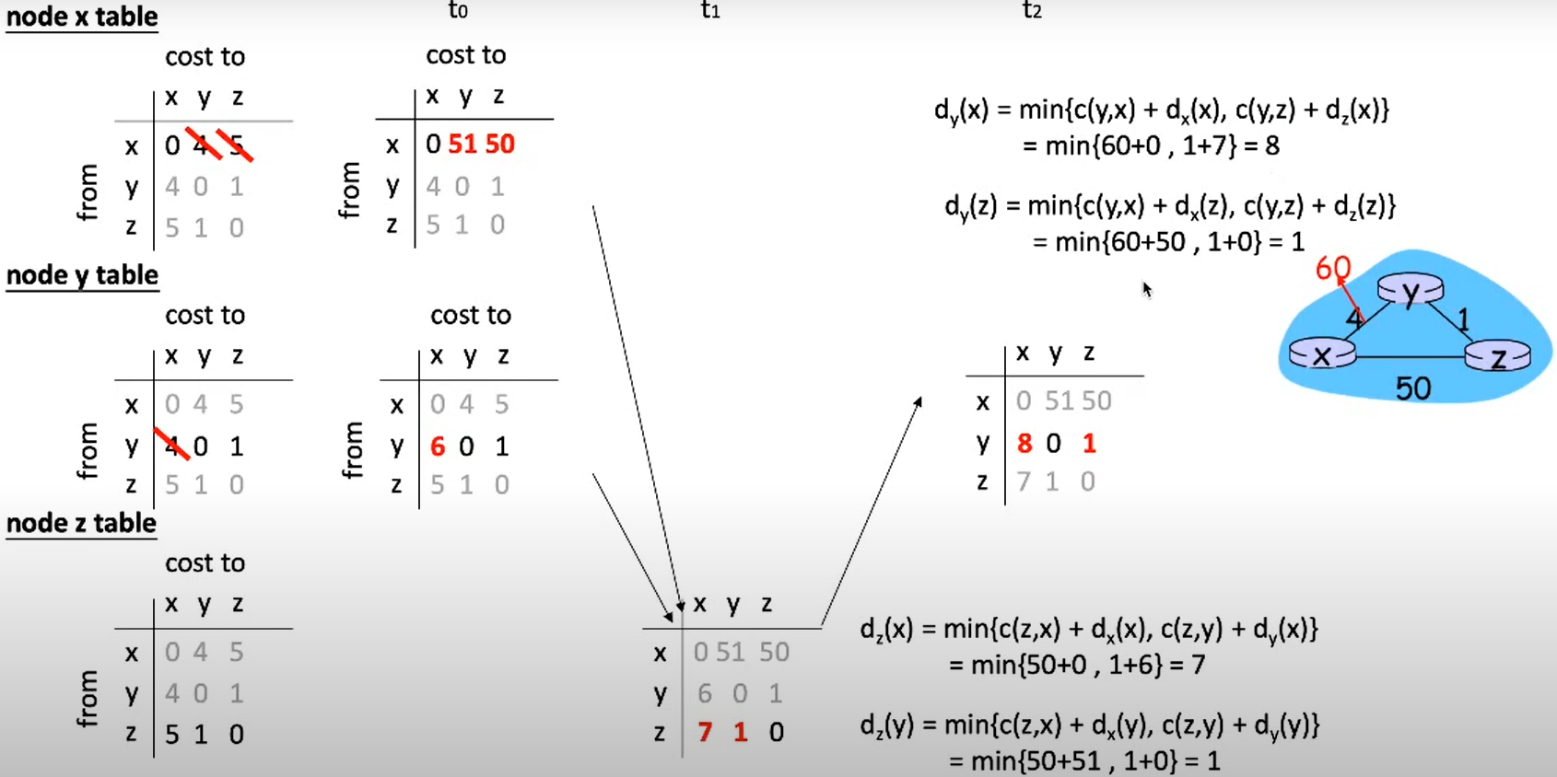
ch52 ep#12 DV Bad News Travel Slow Part II
https://www.youtube.com/watch?v=kLmhxtL2FRI

Slide 57
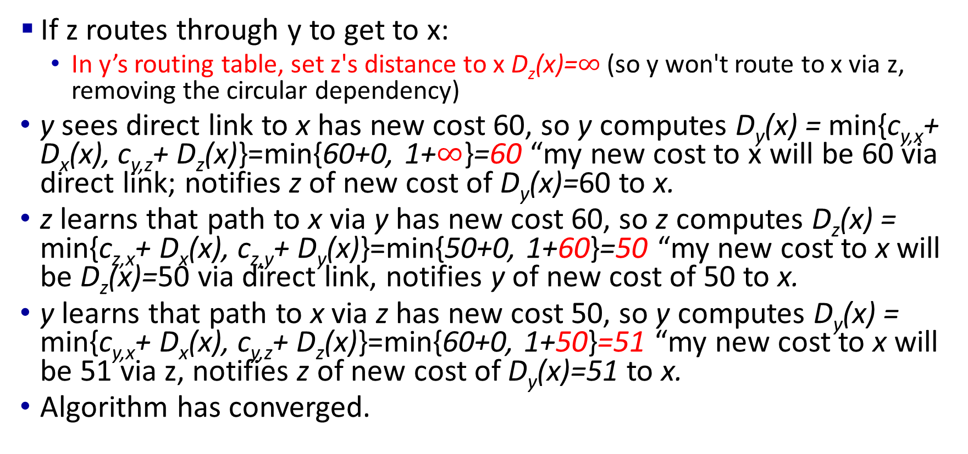
Solution: Poisoned Reverse
IMPORTANT
60
y
4
1
x
z
50
If z routes through y to get to x:
In y’s routing table, set z's distance to x D_{z}(x)=$∞$ (so y won't route to x via z, removing the circular dependency)
y sees direct link to x has new cost 60, so y computes D_{y}(x) = min{c_{y,x}+ D_{x}(x), c_{y,z}+ D_{z}(x)}=min{60+0, 1+$∞$}=60 “my new cost to x will be 60 via direct link; notifies z of new cost of D_{y}(x)=60 to x.
z learns that path to x via y has new cost 60, so z computes D_{z}(x) = min{c_{z,x}+ D_{x}(x), c_{z,y}+ D_{y}(x)}=min{50+0, 1+60}=50 “my new cost to x will be D_{z}(x)=50 via direct link, notifies y of new cost of 50 to x.
y learns that path to x via z has new cost 50, so y computes D_{y}(x) = min{c_{y,x}+ D_{x}(x), c_{y,z}+ D_{z}(x)}=min{60+0, 1+50}=51 “my new cost to x will be 51 via z, notifies z of new cost of D_{y}(x)=51 to x.
Algorithm has converged.

Slide 58
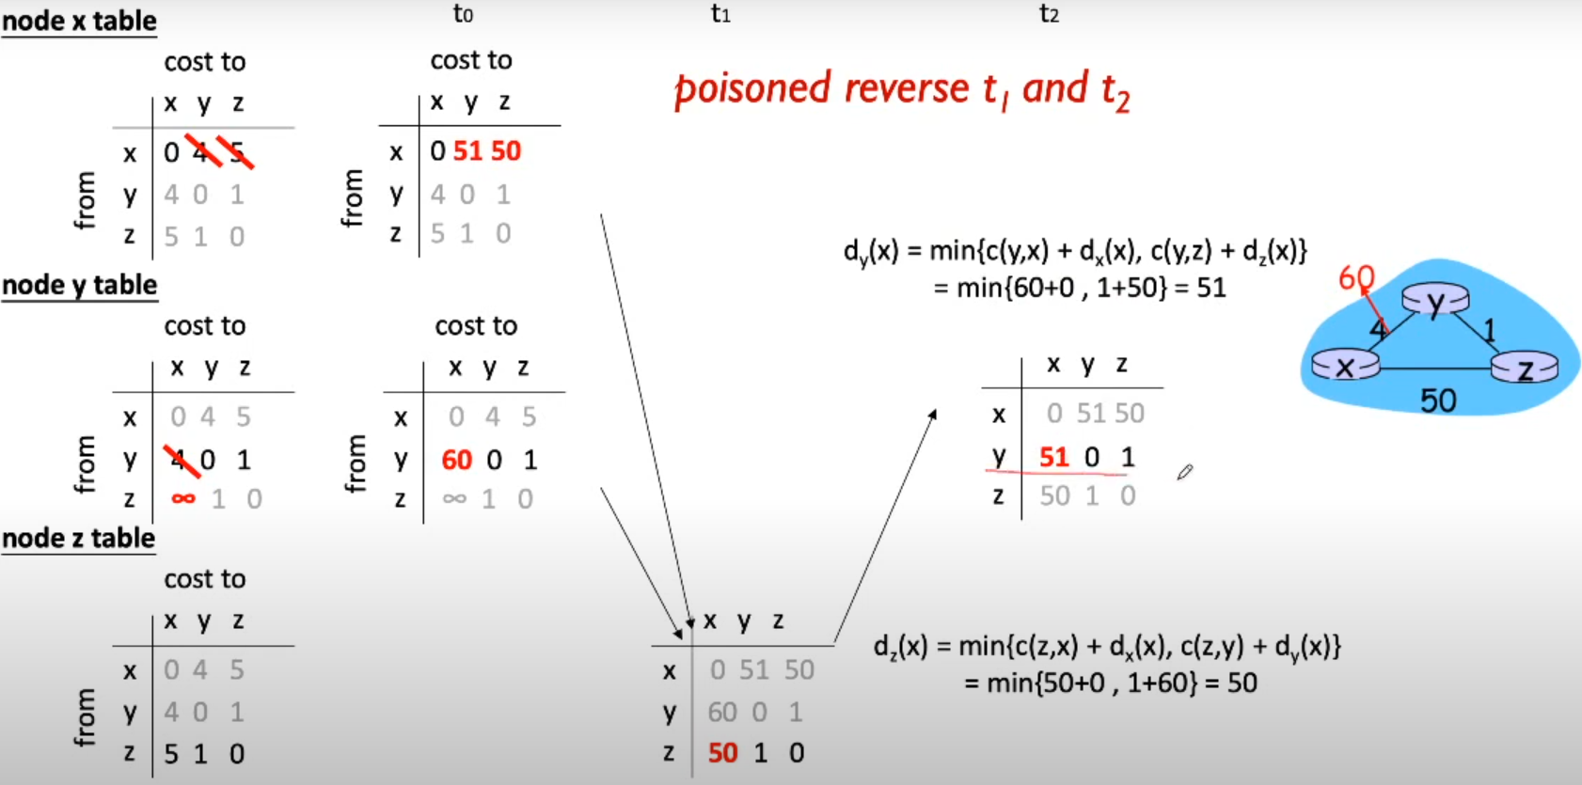
ch52 ep#13 DV Poisoned Reverse
https://www.youtube.com/watch?v=UcTgNZwGmRU

Slide 59
Summary
Link State: Cost of link to neighbors sent to the entire network. Large # of small messages.
n routers, O(n²) messages sent among all routers
Dijkstra’s algorithm is used to compute the shortest path using the link state
Distance Vectors: Distance to all nodes in the network sent to neighbors. Small # of large messages
Message exchange between neighbors; convergence time varies
Bellman Ford’s algorithm is used to compute shortest paths using distance vectors

